Slide 1

Road Hazard Analytics
Supervisor : Eng. Marwan Mokhtar Company : AST
Group code : CAI1_DAT2_S1e

Slide 2
Table of contents
1
2
3
4
5
Our Team
Major Problems
Objectives
6
Dashboard & Recommendations
Tools
Data overview

Slide 3

Our team
Mohamed
Ahmed Saad
Abdelrahman Mahmoud Ibrahim

Slide 4

Problems
Seasonal Variation in Incident Rates.
High-Risk Road Features.
Impact of Adverse Weather Conditions.

Slide 5
Problems
Nighttime Driving Risks.
Weekend Incident Spikes.
Severe Incidents in Certain Locations.

Slide 6
Objectives
analyze traffic incident data comprehensively to identify patterns, contributing factors, and high-risk areas, ultimately improving road safety. By examining trends across different periods, such as months, days, and times, the project aims to pinpoint when incidents are most likely to occur, such as the observed increase from September to October. Understanding these time-based trends allows for the implementation of targeted safety measures during higher-risk periods.

Slide 7
Objectives
The project also seeks to assess how various road features, including junctions, traffic signals, and crossings, influence the frequency and severity of incidents. This insight will help enhance road design and optimize traffic management strategies. Furthermore, the analysis extends to the impact of adverse weather conditions, such as rain or fog, on incident rates. Understanding these effects can guide improved road maintenance and driver warning systems during poor weather.

Slide 8
Objectives
A significant focus is placed on addressing elevated risks associated with nighttime driving and weekend travel, as data shows these times are linked to more frequent incidents. The aim is to explore ways to mitigate these risks through better road lighting, increased law enforcement presence, and targeted public awareness campaigns.

Slide 9
Objectives
Additionally, the project aspires to predict future incident trends by leveraging historical data, enabling proactive planning and resource allocation to prevent accidents and save lives. By evaluating the effectiveness of current safety interventions, the project seeks to identify areas for improvement, ensuring that resources are used efficiently for road safety enhancements. Ultimately, the goal is to use data-driven insights to create safer roads, reduce accidents, and improve the quality of life for all road users.

Slide 10
Tools
Cleaning and feature engineering :-
Python :
NumPy
Pandas

Slide 11
Tools
Data Exploration and Querying :-
SQL Server Management Studio (SSMS)
PostgreSQL

Slide 12
Tools
Data Visualization and Dashboard:-
Power BI Desktop

Slide 13
Data Overview
The dataset covers traffic incident records for a two-year period, from January 2018 to December 2019, across 49 states in the USA.
It includes details on approximately 1.6 million traffic incidents, with information on road characteristics, weather conditions, and severity.
Data sources: Collected via federal and state transportation departments, law enforcement agencies, traffic cameras, and traffic sensors.

Slide 14
Data Overview
Key features:
Time and Location: Incidents are categorized by day, month, hour, street, city, state, and timezone.
Weather and Environmental Conditions: Includes attributes like temperature, humidity, wind speed, visibility, and specific weather conditions at the time of the incident.
Road Characteristics: Records if the road had specific features such as junctions, traffic signals, crossings, or other infrastructure.
Severity Levels: Incidents are classified by severity, helping to identify the most dangerous situations.

Slide 15
Dashboard & Recommendations

Slide 16
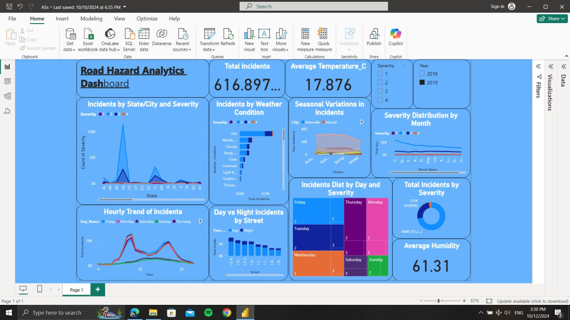
Dashboard

Slide 17
Recommendations
Implement seasonal safety campaigns during the fall, especially in October, when incidents are highest. This could include increased road safety advertising, public awareness campaigns about driving conditions during fall, and proactive road maintenance.
Issue weather-specific driving advisories to encourage safer driving behaviors during adverse conditions. Authorities could also consider deploying more traffic control personnel and resources during bad weather and ensuring roads are cleared and treated (e.g., salting icy roads).
Optimize traffic signal timings, install roundabouts where feasible, and implement additional safety features like better signage, rumble strips, or traffic calming measures around junctions.

Slide 18
Recommendations
Enhance law enforcement and road safety monitoring on weekends. Consider more stringent DUI checks and speed monitoring, as well as targeted road safety campaigns encouraging cautious driving during weekends.
Focus safety improvements on identified high-risk streets. Install advanced safety measures such as better street lighting, increased police presence, or even physical road modifications (e.g., speed bumps) in these areas.
Improve street lighting, enhance visibility of road markings, and consider night driving safety programs, such as offering free vision checks or distributing anti-glare glasses to drivers.

Slide 19
Recommendations
Develop a real-time incident detection and response system that uses live data to alert authorities about potential hazards. This could help in deploying emergency services faster, setting up roadblocks, or sending alerts to drivers.
Allocate more resources, such as traffic patrols and emergency services, during these peak months. Conduct infrastructure inspections beforehand to ensure roads are well-maintained.

Slide 20

Thanks !!

